Slide 1

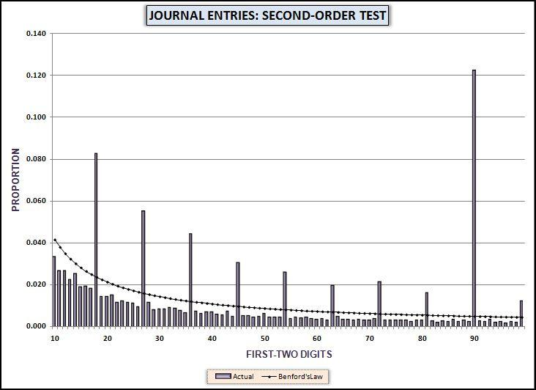
Chapter 7
Second-order test – any data set
Summation test – large numbers
Analysis of journal entries
Access and Excel
Prepared by:
Mark J. Nigrini
Copyright © 2012 by Mark J. Nigrini. All rights reserved.
Notes:
Pages 130 to 152.
introduces the second-order test (based on the digits of the differences) and the summation test based on the sums of the numbers.

Slide 2
conformity to Benford
Digits of the differences between the records of a geometric sequence conform to Benford’s Law
Digits of the differences between the records from almost all other distributions are almost Benford
If the digits of the differences are not close to Benford it indicates that some anomaly is present
Notes:
Page 132.
General discussion of second-order test.

Slide 3
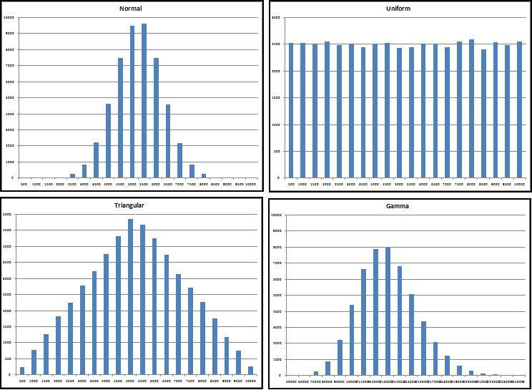
simulated data
Notes:
Page 134.
Figure 7.2.
Histograms of four data sets with 50,000 records each created in Minitab. Normal, uniform, triangular, and gamma distributions.

Slide 4
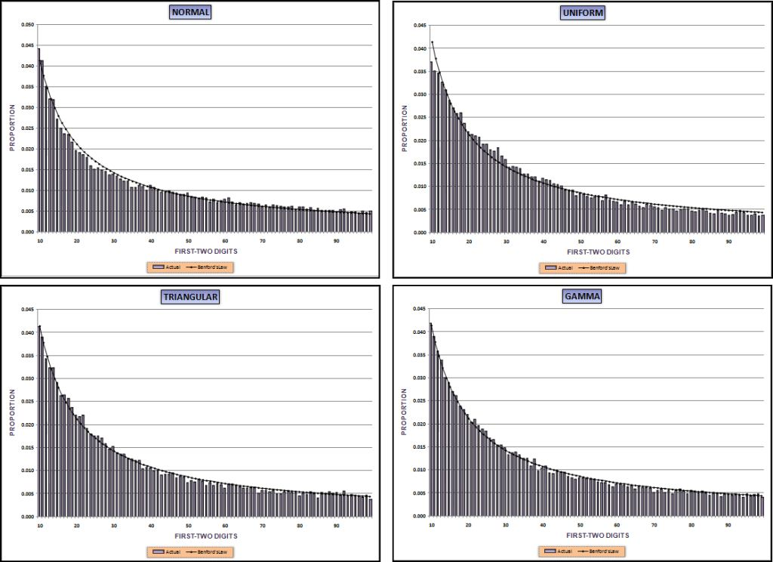
Digits of the differences
Notes:
Page 136.
Figure 7.3.
In each case the digits of the differences are almost Benford.

Slide 5
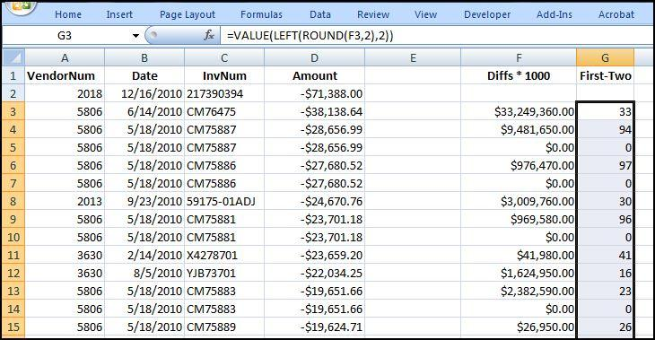
using excel
Notes:
Page 138.
Figure 7.5.
The second-order test cannot be run in Access. Access cannot easily calculate the differences between the sorted records. So if the 1000th record was for $$2,104 and the 1001th record was for $2,150, Access cannot easily calculate that the difference is $46.
After the sort procedure in Excel, the next step is to create a new field Diffs (for differences) in column F. The first-two digits of the differences are calculated in column G. The template is used to count the digits and to graph the results.

Slide 6
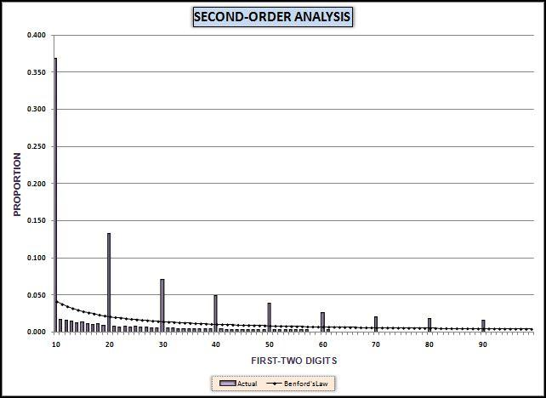
invoice data results
Notes:
Pages 139 to 140.
Figure 7.7.
The InvoicesPaid numbers are tightly clustered. There were 139,105 records with an Amount field from $10.00 to $999.99. Most of the numbers in the range are probably used by one or more invoices. 39,897 of the available numbers between 10 and 999.99 were used. The differences between the numbers in the 10.00 to 999.99 range are generally small and are probably 0.01, 0.02, and 0.03.
A difference of 0.01 has first-two digits of 10 because this number can be written as 0.010. A difference of 0.02 has first-two digits of 20 because 0.02 can be written as 0.020. The reason for the prime spikes is that the numbers are tightly packed in the $10.00 to $999.99 range with almost three-quarters of the differences being 0.01 or 0.02. The mathematical explanation is that the InvoicesPaid table is not made up of numbers from a continuous distribution. Currency amounts can only differ by multiples of $0.01. The prime spikes should occur with any discrete data (e.g., population numbers) and the size of the prime spikes is a function of both N and the range. That is, we'll get larger prime spikes for larger data tables with many records packed into a small range. This pattern of spikes does not indicate an anomaly, it is a result of a lot of numbers restricted to being integers or to fractions such as 1/100, 2/100, 3/100, being fitted into a tight range thereby only allowing small differences between adjacent numbers.

Slide 7
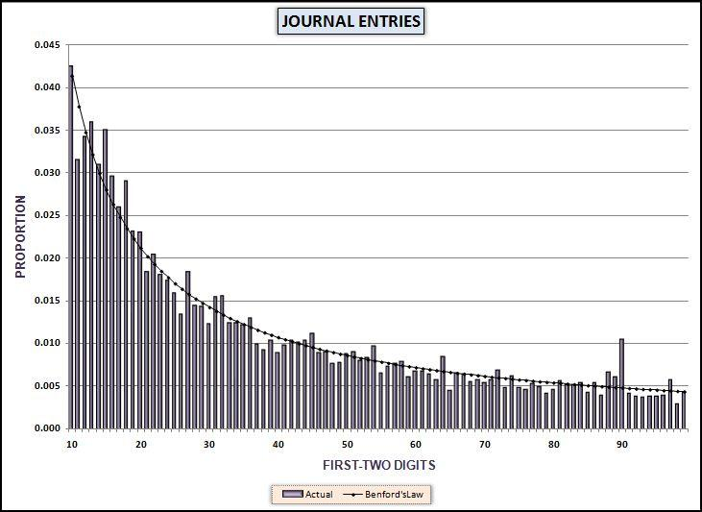
journal entries
Notes:
Pages 141 to 144.
Figures 7.8 and 7.9.
There is no spike at 10 and a large spike is expected for data representing dollars and cents in tightly clustered data due to differences of 0.01 which have first-two digits of 10 (since 0.01 is equal to 0.010). Second, there is a large spike at 90 and while spikes are expected at the prime digits, the largest of these is expected at 10 and the smallest at 90. Third, there is an unusual spike at 99. The 99 has the lowest expected frequency for both the first-order and second-order tests.
An analysis of the data showed that while the data was formatted as currency with two digits to the right of the decimal point (e.g., $11.03), there were amounts that had a mysterious nonzero third digit to the right of the decimal point.
In the journal entry data the second-order test showed a data inconsistency that was not apparent from the usual Benford’s Law tests and also not apparent from any other statistical test used by auditors.

Slide 8
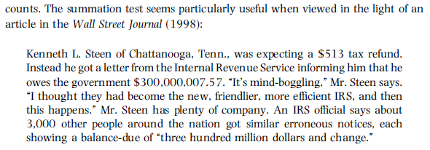
summation test
Notes:
Pages 144 to 150.
Motivation for the summation test.

Slide 9
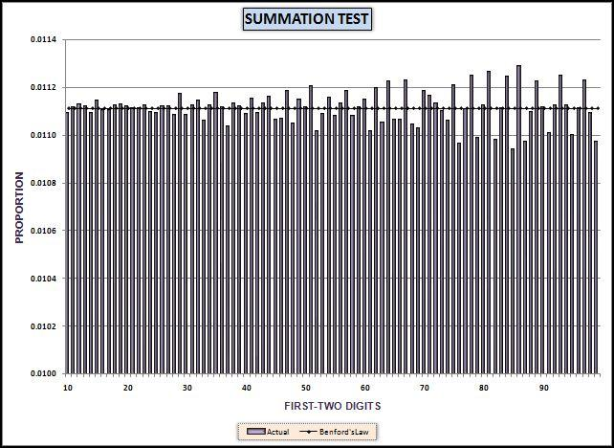
summation simulation
Notes:
Page 147.
Figure 7.13.
The summation bars are all very close to the expected values of 0.0111. Some variability can be seen as we move from left to right. This is because the actual and expected counts are lower for the higher digits and sometimes the simulation generates slightly fewer than expected or slightly more than expected records with a (say) first-two digits of 85. Since we're dealing with sums it looks like a large effect. Note the calibration of the y-axis. The minimum value is 0.01 and the actual sums are actually very close to the 0.111 expectation.

Slide 10
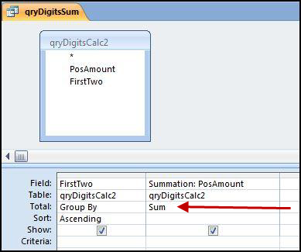
summation in access
Notes:
Pages 148 to 150.
Figure 7.16.
The second summation test query is shown in Figure 7.16. The first-order test counts the amounts whereas the summation test sums the positive amounts. The sums are grouped by the first-two digits. The result can be copied and pasted using Copy and Paste into the NigriniCycle.xlsx template also using column Q as is shown in Figure 7.12.

Slide 11
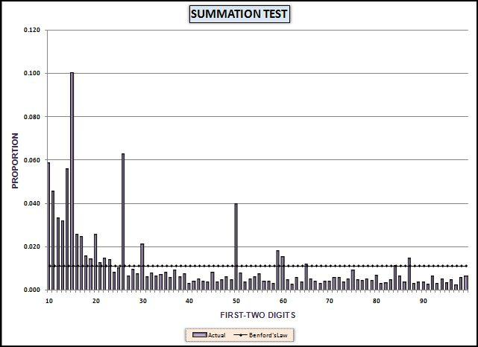
invoices data: summation
Notes:
Pages 149 to 150.
Figure 7.17.
The summation graph shows little conformity to Benford's Law. The graph indicates that we have an excess of large numbers with first-two digits 10, 11, 14, 15, 26, and 50. These results will be investigated further in Chapter 8.
Experimentation with the summation theorem has shown that real-world data sets seldom show the neat straight-line pattern in the simulation even though this is the correct theoretical expectation. In the real-world we do have abnormal duplications of large numbers. At this stage we can't say whether the summation spikes are caused by a handful (one, two, or three) very big numbers or an abnormal duplication of a few hundred moderately big numbers.

Slide 12
summary
Simulations showed that the digits of the differences were almost Benford
For currency or integer data we will usually get spikes on the prime digits
Second-order test showed anomalies in journal entries
Summation test is based on the sums of the numbers with the same FT digits
Summation test shows abnormally large numbers or groups of moderately large numbers with the same FT digits
Summation test showed spikes for invoices data
Notes:
Pages 151 and 152, and a review of the main points.

